Slide 1

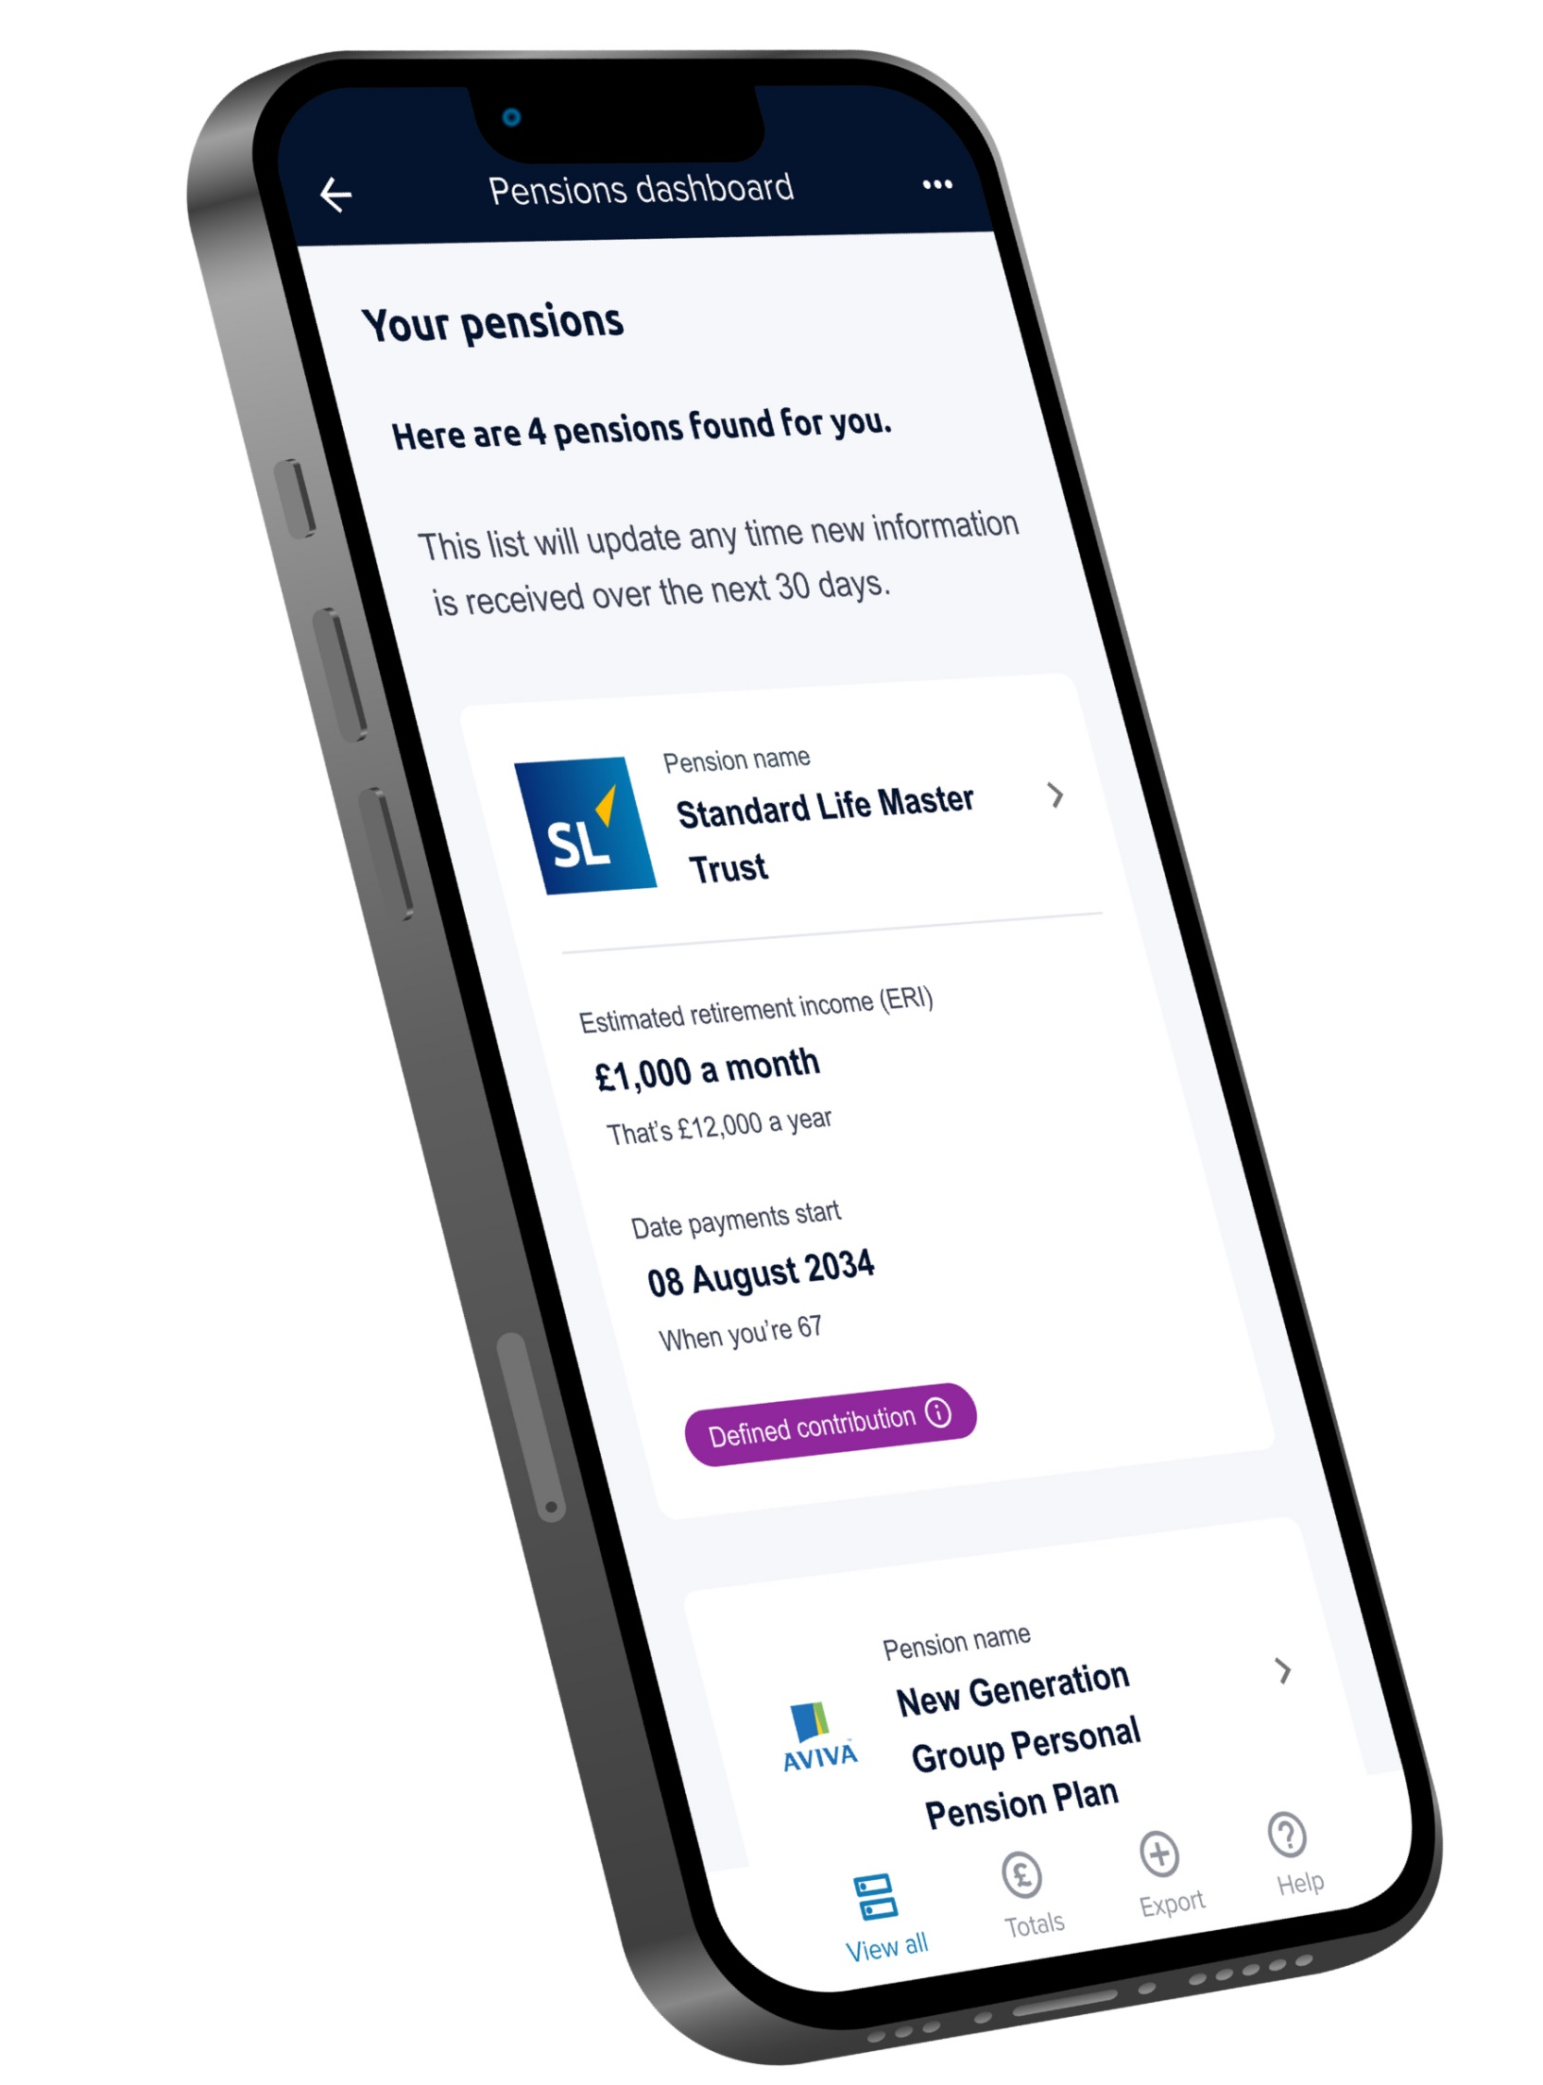






Pensions Dashboards and Consumer Segmentation
Pension PlayPen Online Coffee Morning Tuesday 14 October 2025, 10:30-11:30
Richard Smith Independent Pensions Dashboards Consultant
Previous dashboards roles (click logos):
Dashboards blog (since 2014): DashboardIdeas.co.uk

Slide 2

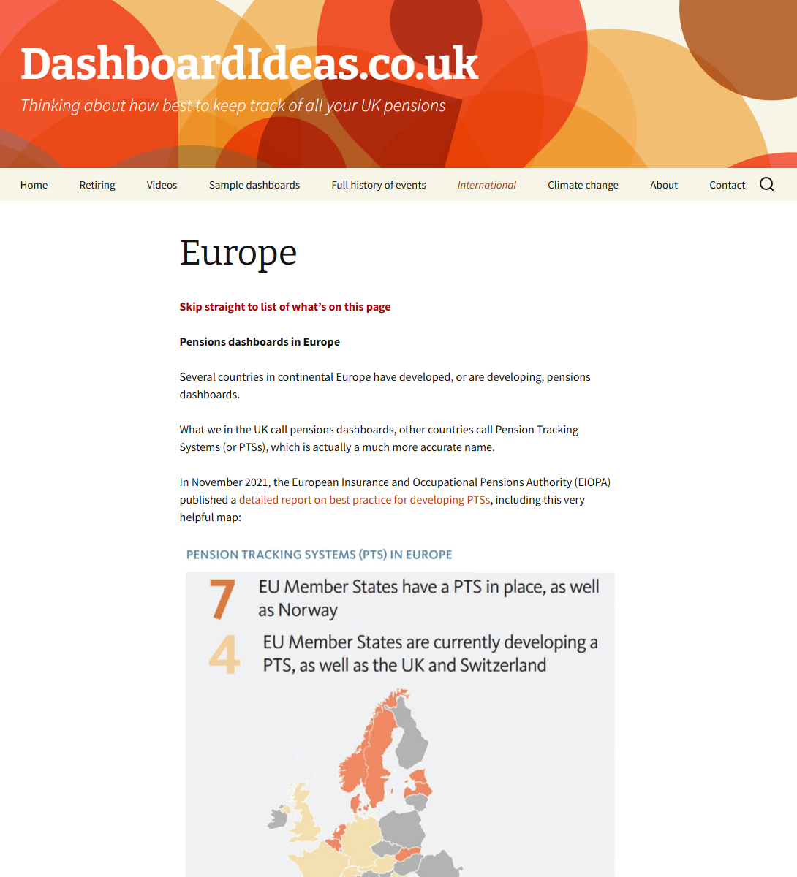
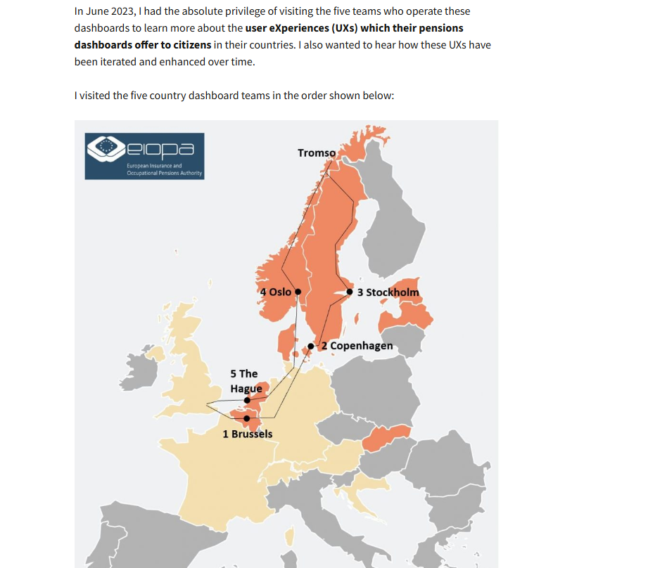

Slide 3
Pensions Dashboards and Consumer Segmentation
Pension PlayPen Online Coffee Morning Tuesday 14 October 2025, 10:30-11:30
Richard Smith Independent Pensions Dashboards Consultant
Previous dashboards roles (click logos):
Dashboards blog (since 2014): DashboardIdeas.co.uk

Slide 4
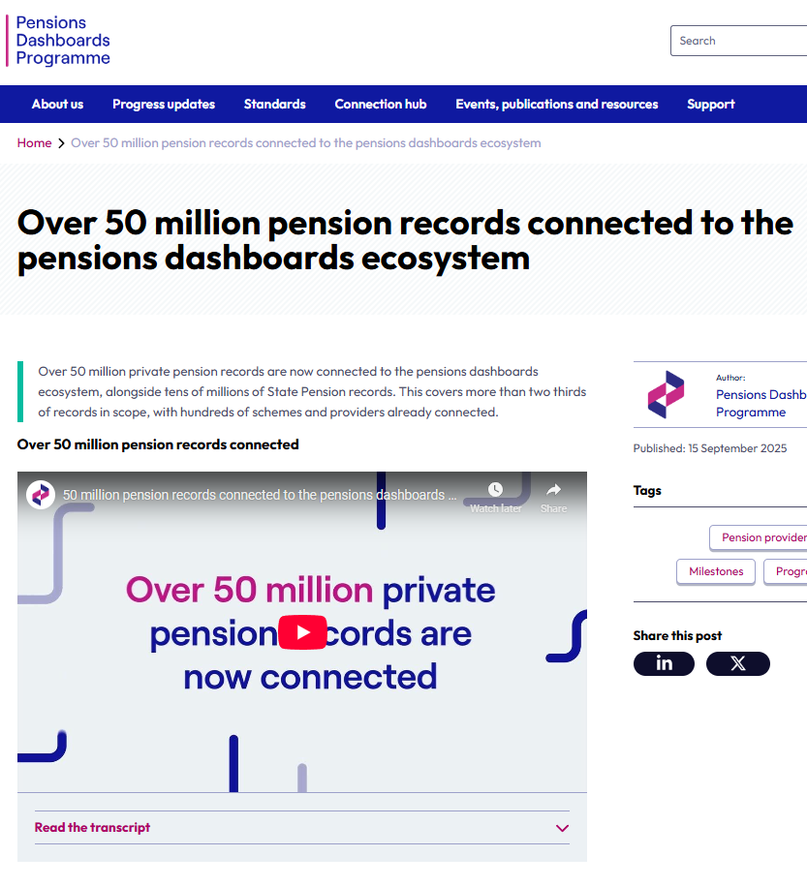
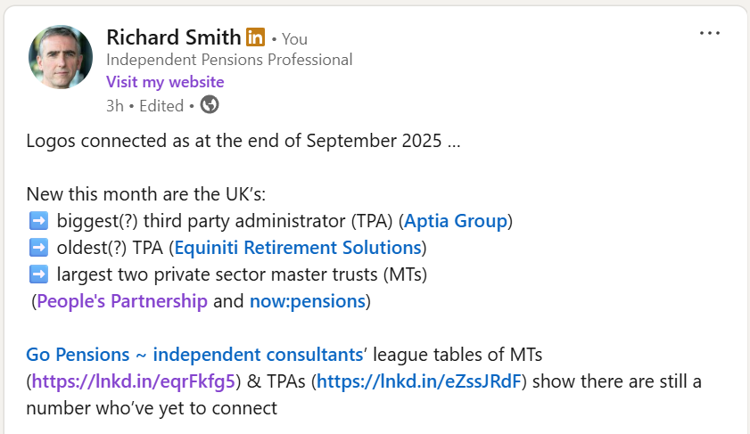
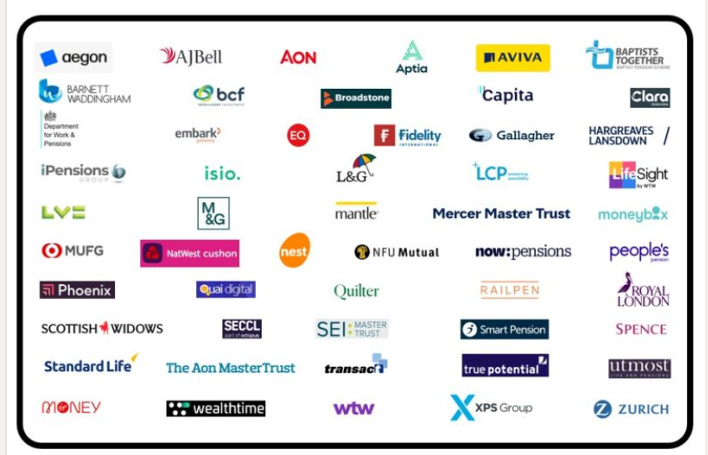

Slide 5
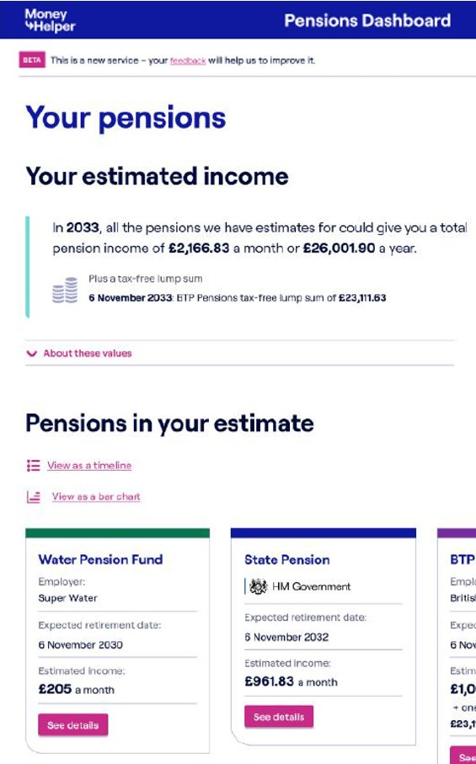
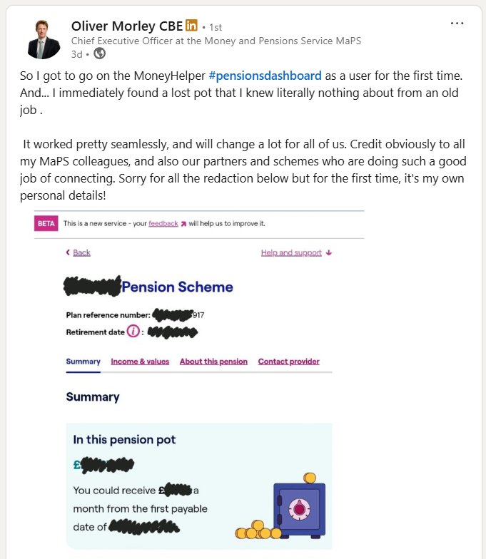

Slide 6
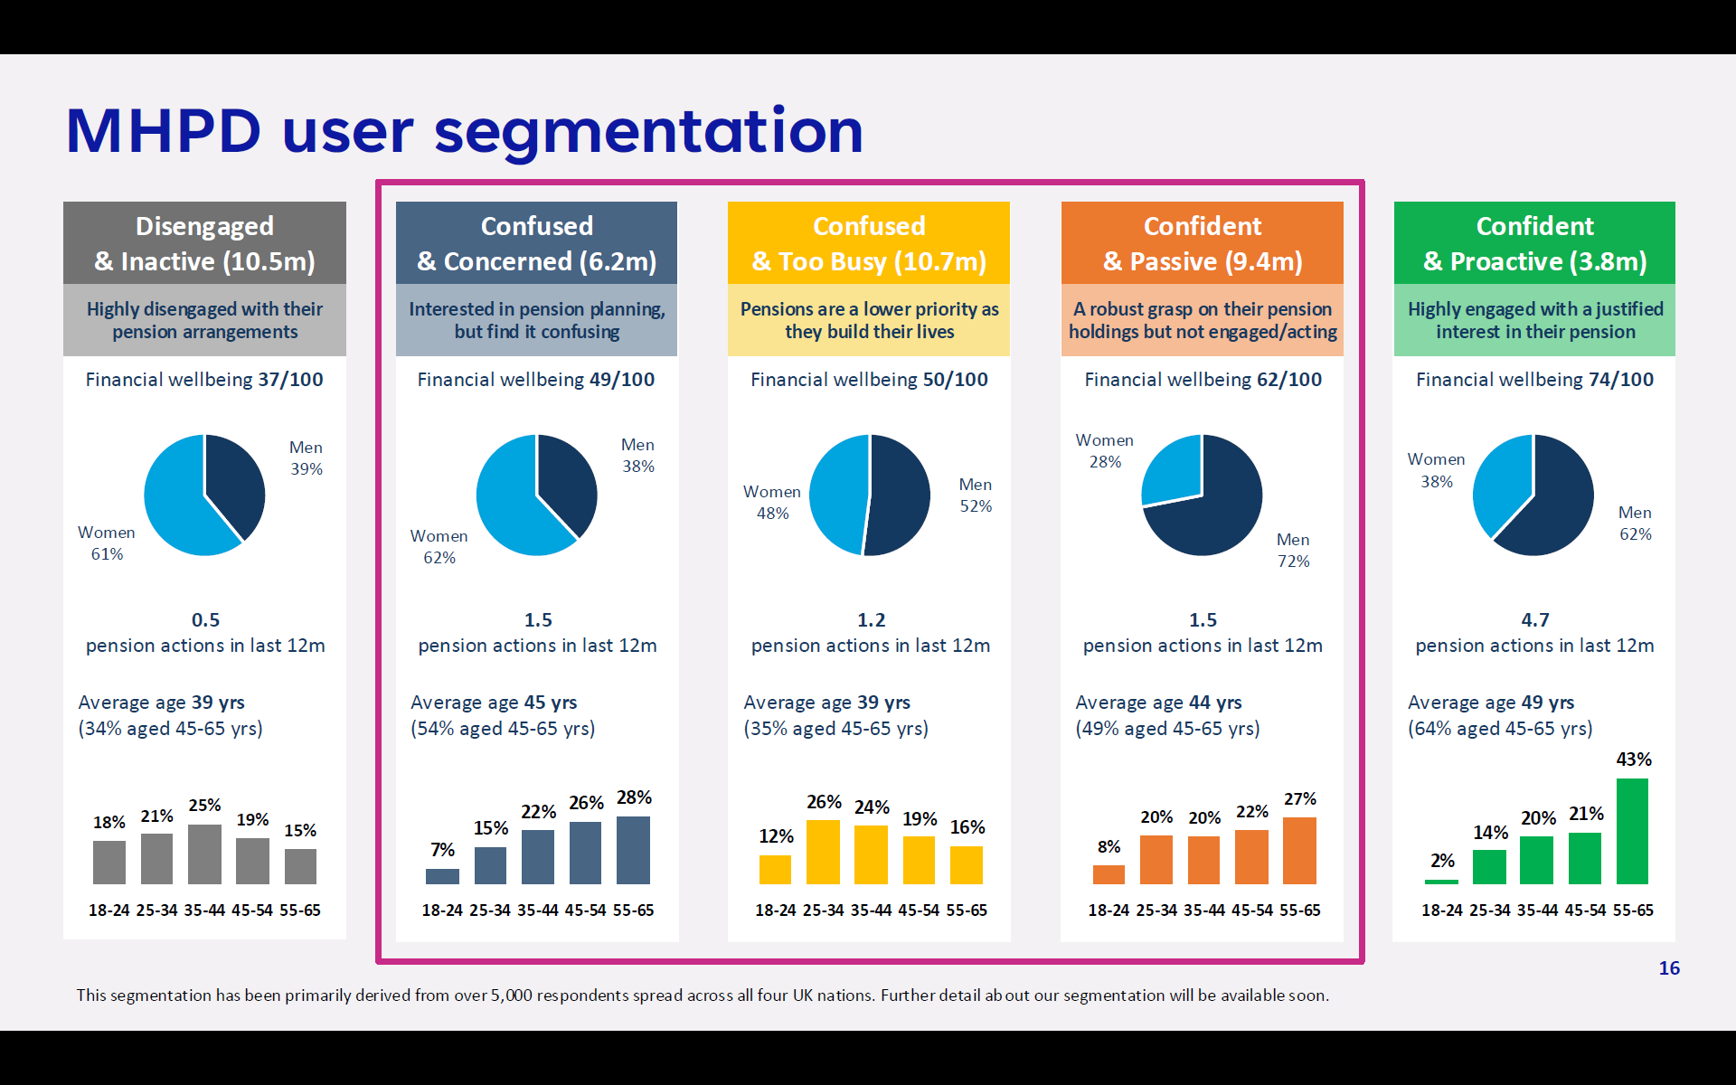

Slide 7
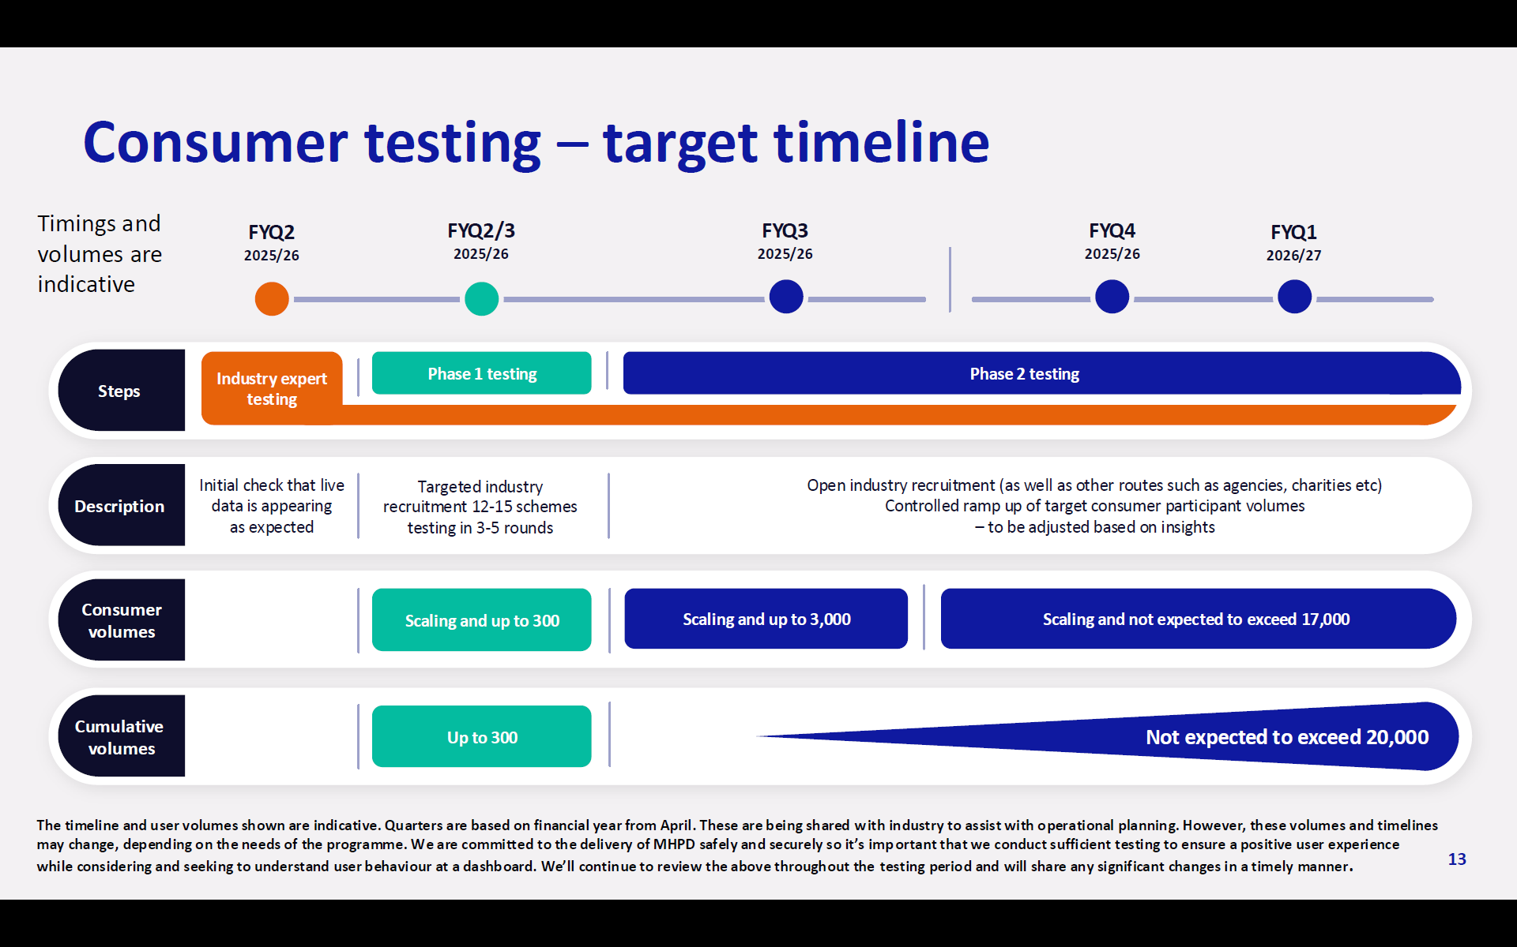
(Jul 2025)

Slide 8
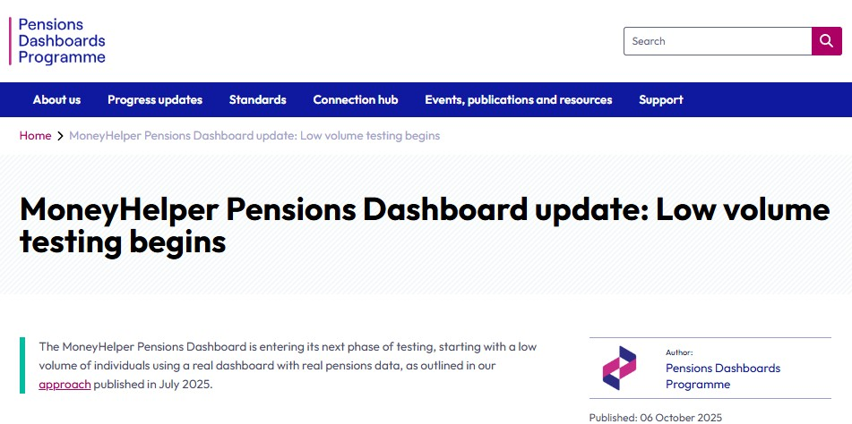

Slide 9
MHPD
(Oct 2025)
This timeline was published in July 2025 by the Money & Pensions Service (MaPS), on p13 of their Consumer Testing approach. Indicative dates have been updated to reflect Phase 1 (green) consumer testing commencing in Oct 2025.
Jul-Sep 25
Oct 25-Mar 26
Jan-Mar 26
Apr-Jun 26
Jul-Sep 26

Slide 10
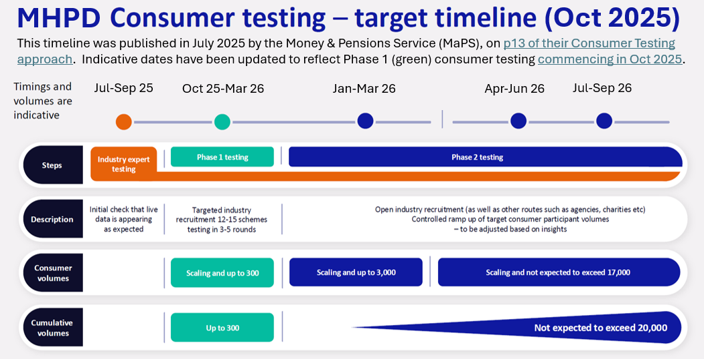
Possible MHPD launch timeline? – no more than Richard’s guess
2025
2026
2027
2028

Slide 11
Possible MHPD launch timeline? – no more than Richard’s guess
2025
2026
2027
2028
6-month notice of public launch
MHL – MoneyHelper Launch??? Public availability of the MoneyHelper Pensions Dashboard (MHPD) – potentially in Spring / Summer 2027
maybe? (it all depends on the testing)

Slide 13
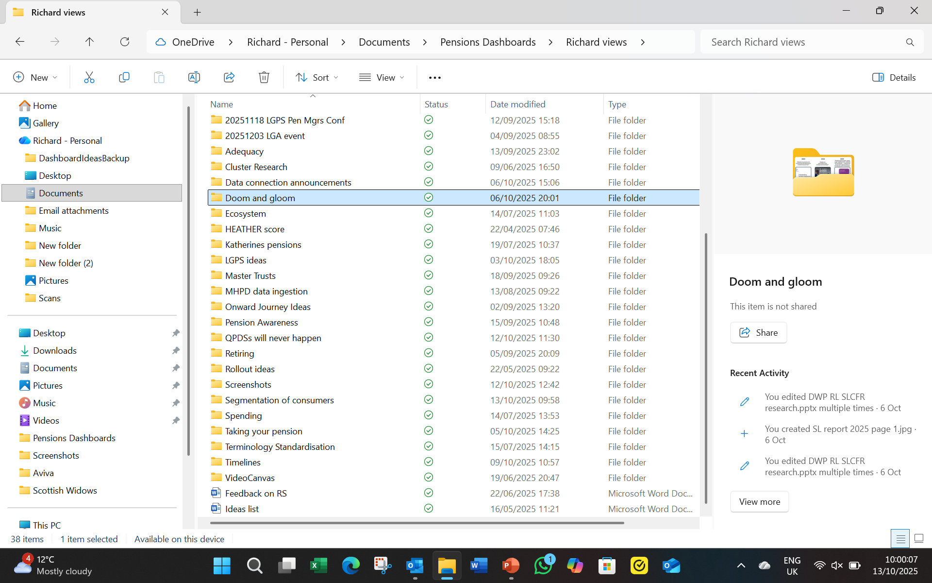

Slide 14
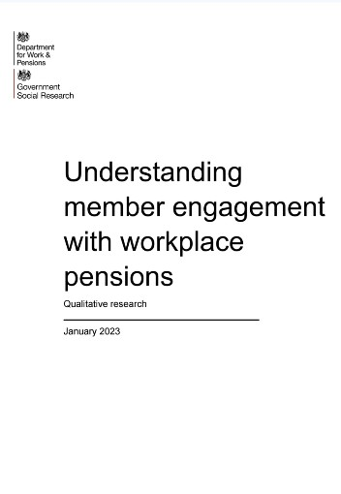


2023
2024
2025
“People express regret, shame, anger, hopelessness, confusion and overwhelm … underpinned by low trust in government, in the industry, and in themselves”
“Attitudes to pensions are characterised by detachment, complacency and fear”
“People are more likely to feel anxiety and uncertainty”
In-depth qualitative interviews with 60 individuals with workplace pensions
Online survey 4,500 UK adults all with one or more pensions
Deliberative panel of 30 consumers approaching, or in, retirement

Slide 16
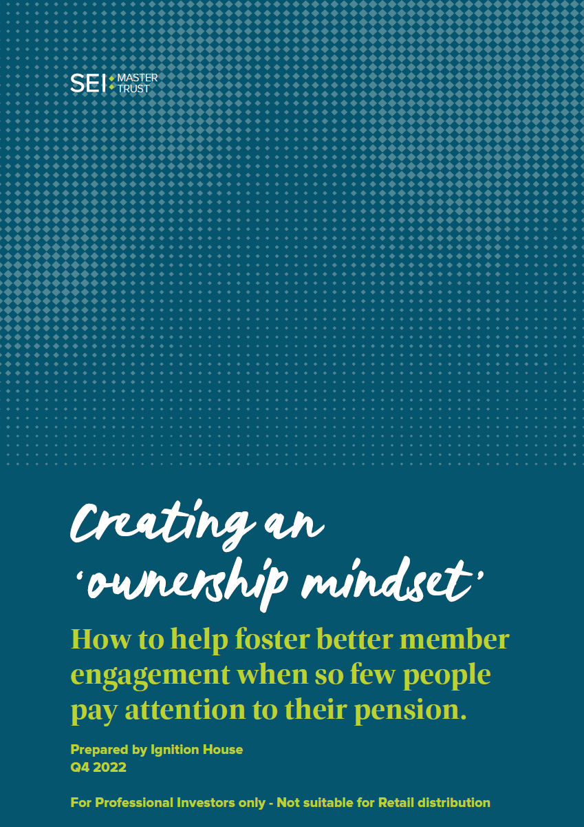
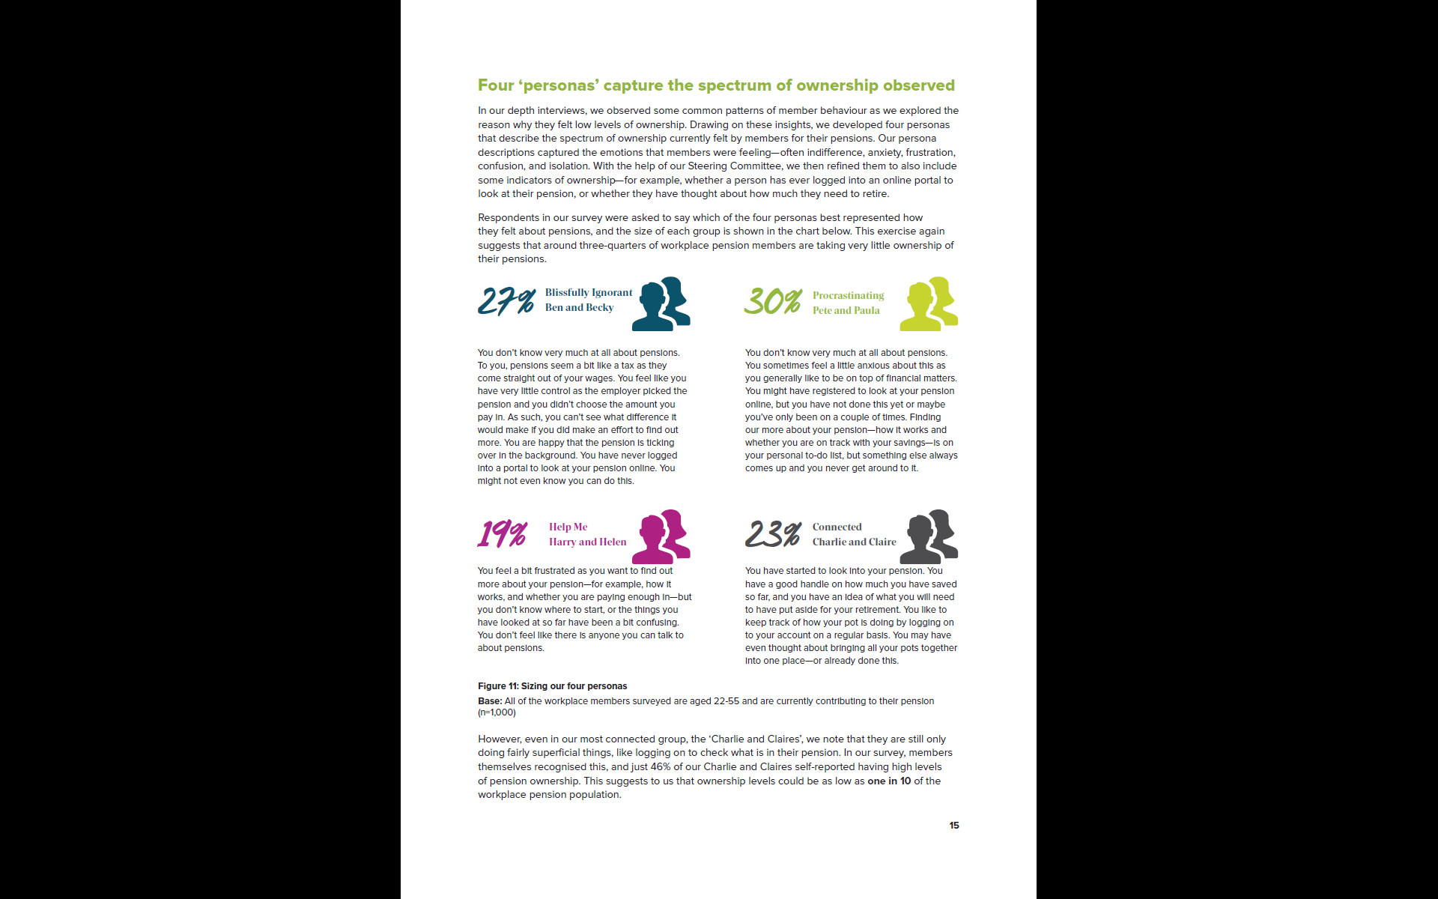
SEI Master Trust research, by Ignition House, 2022

Slide 17
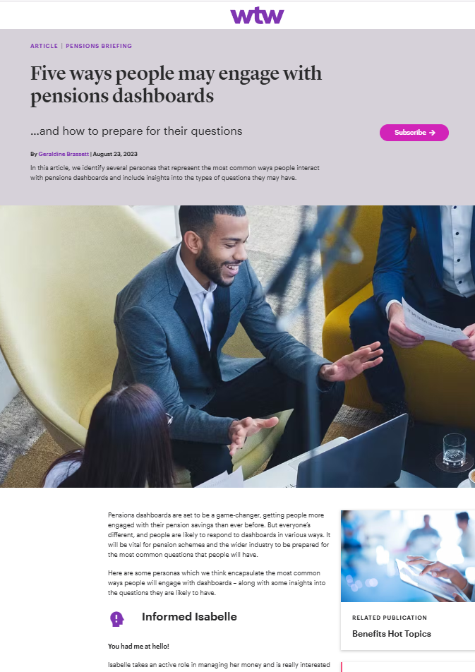
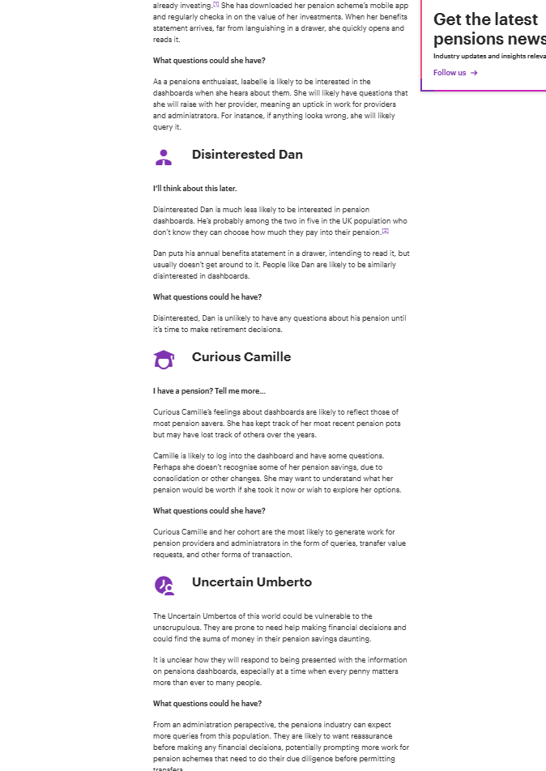
WTW blog article drawing on administration experience, 2023

Slide 18
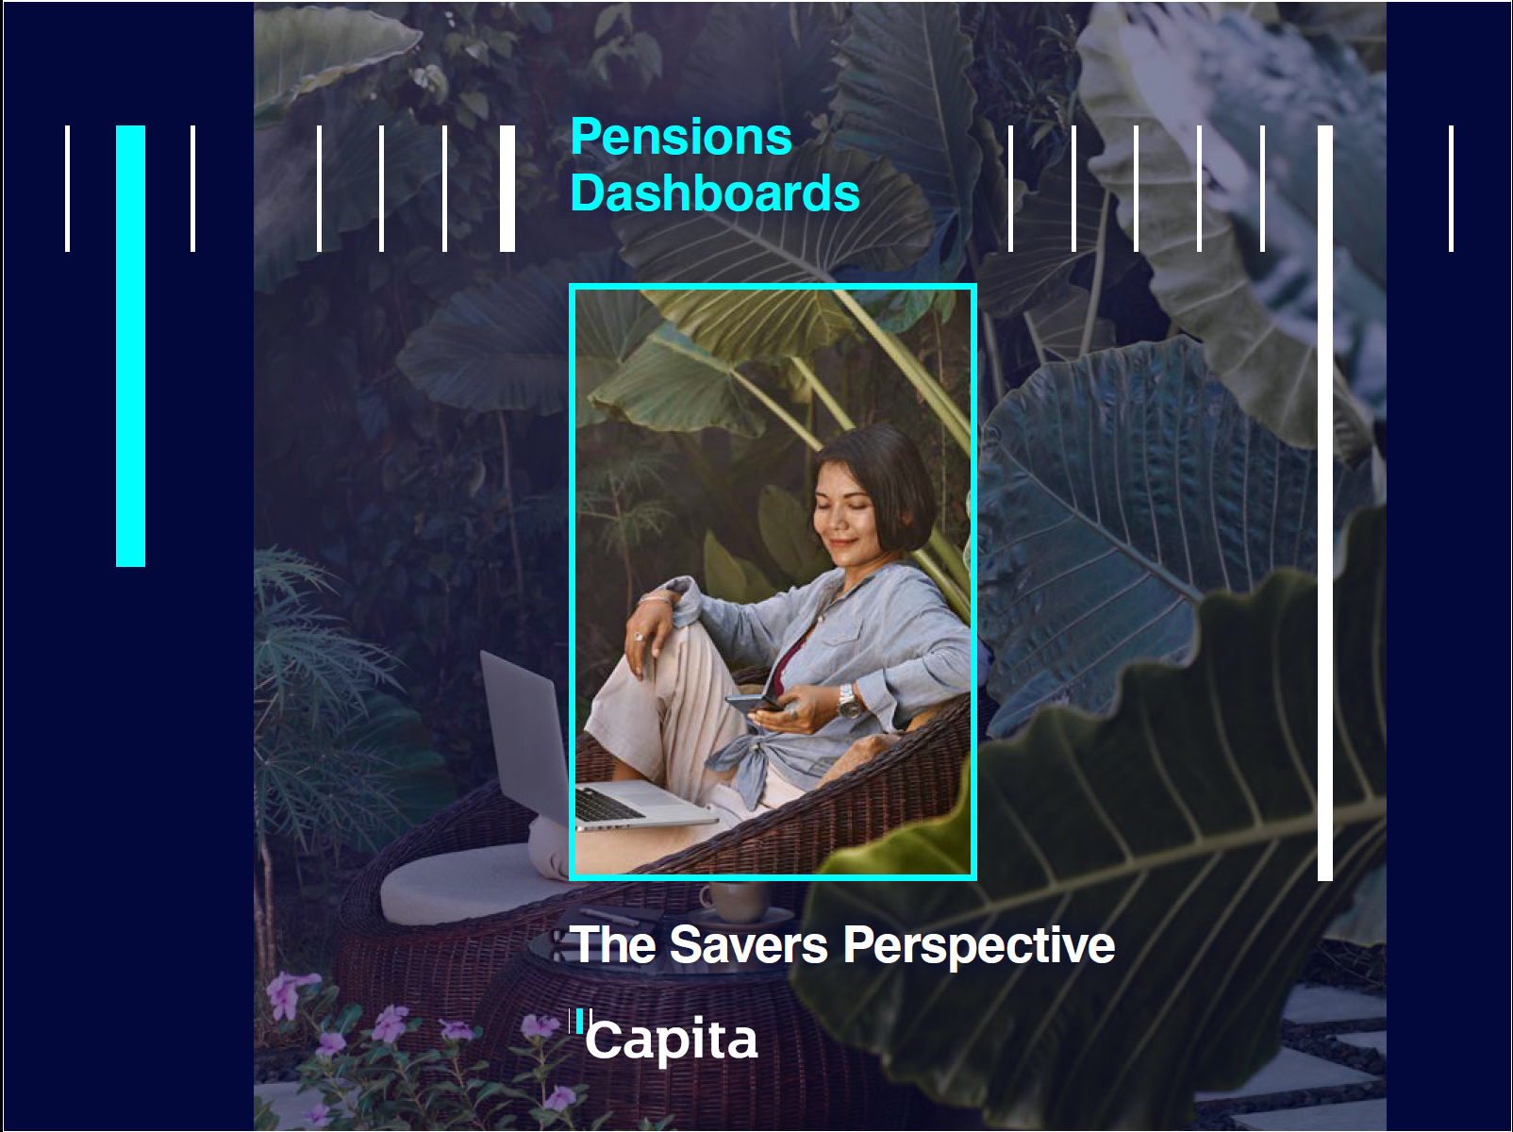
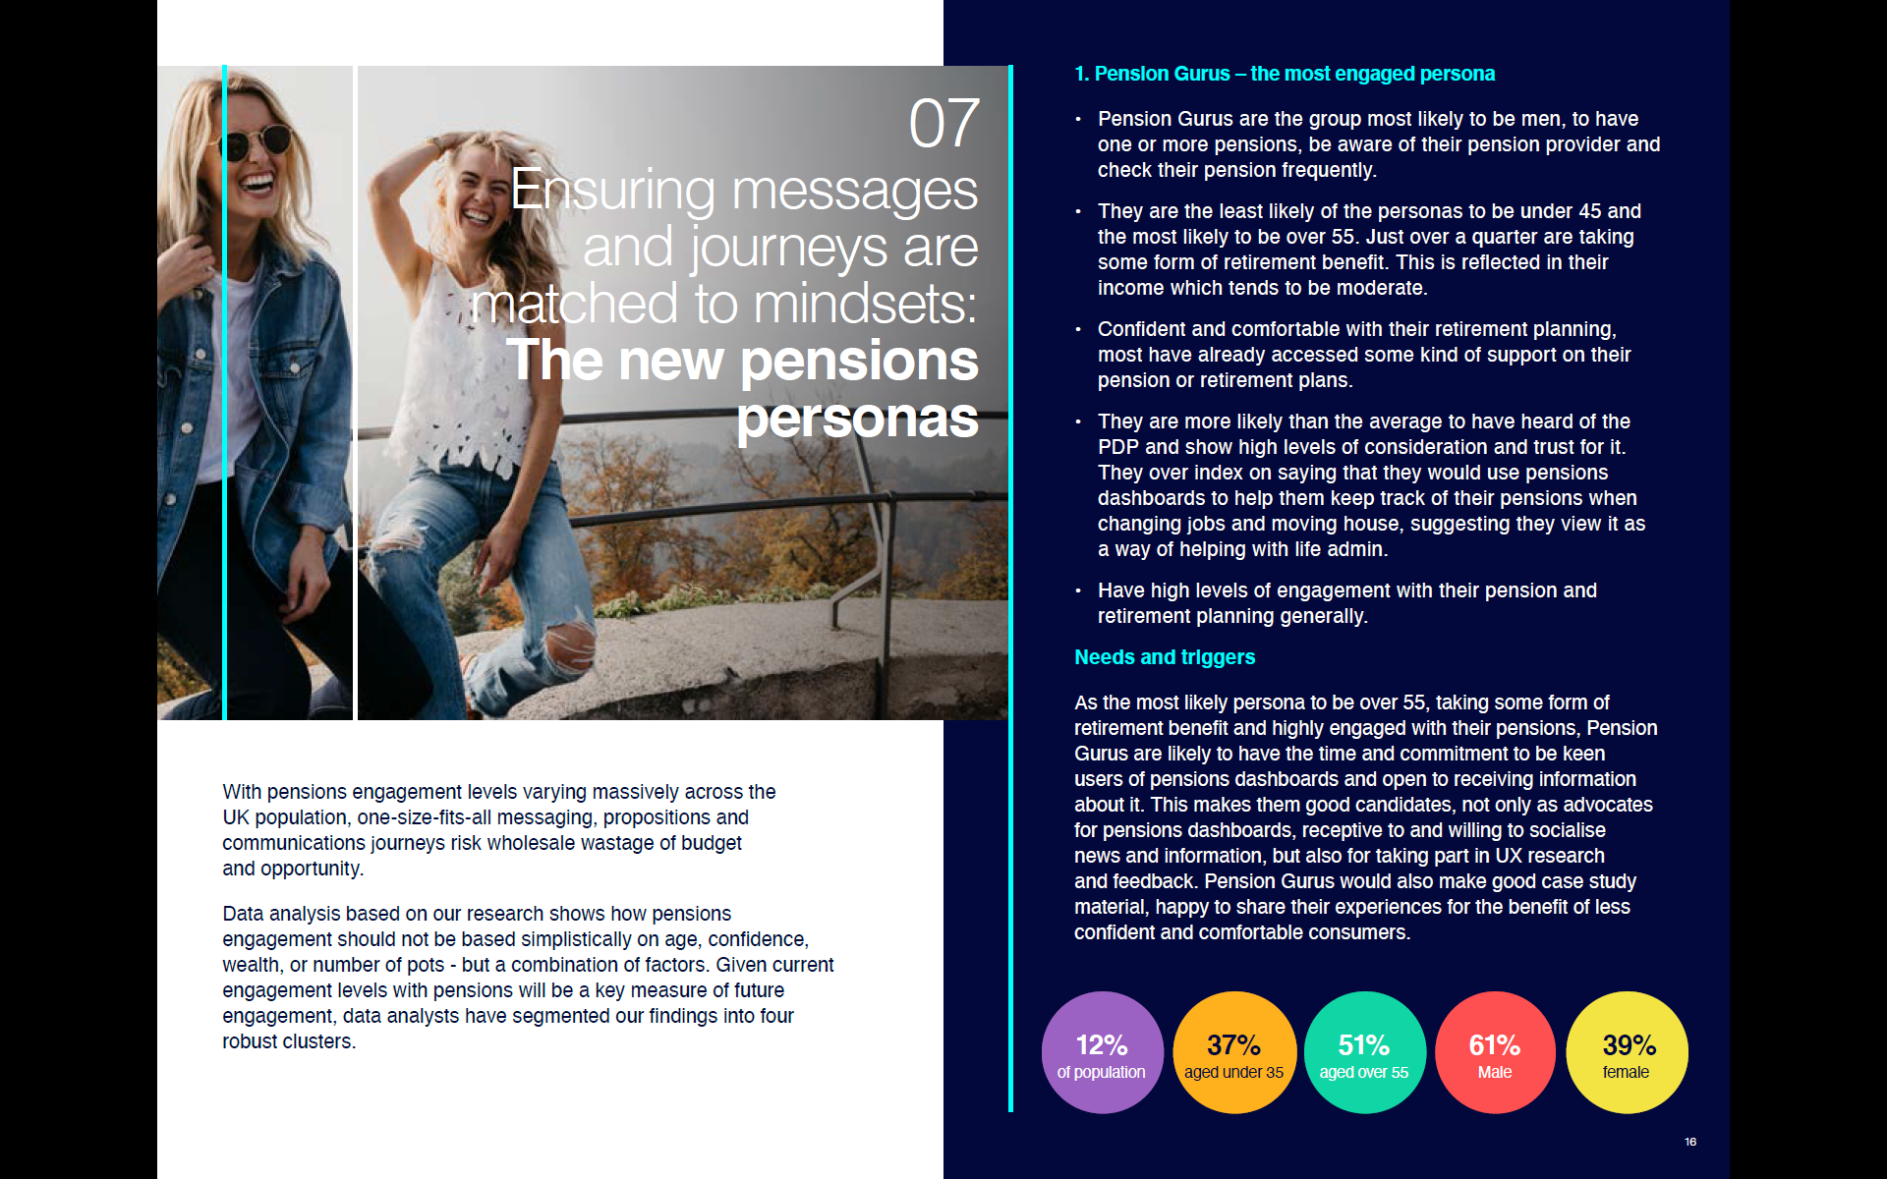
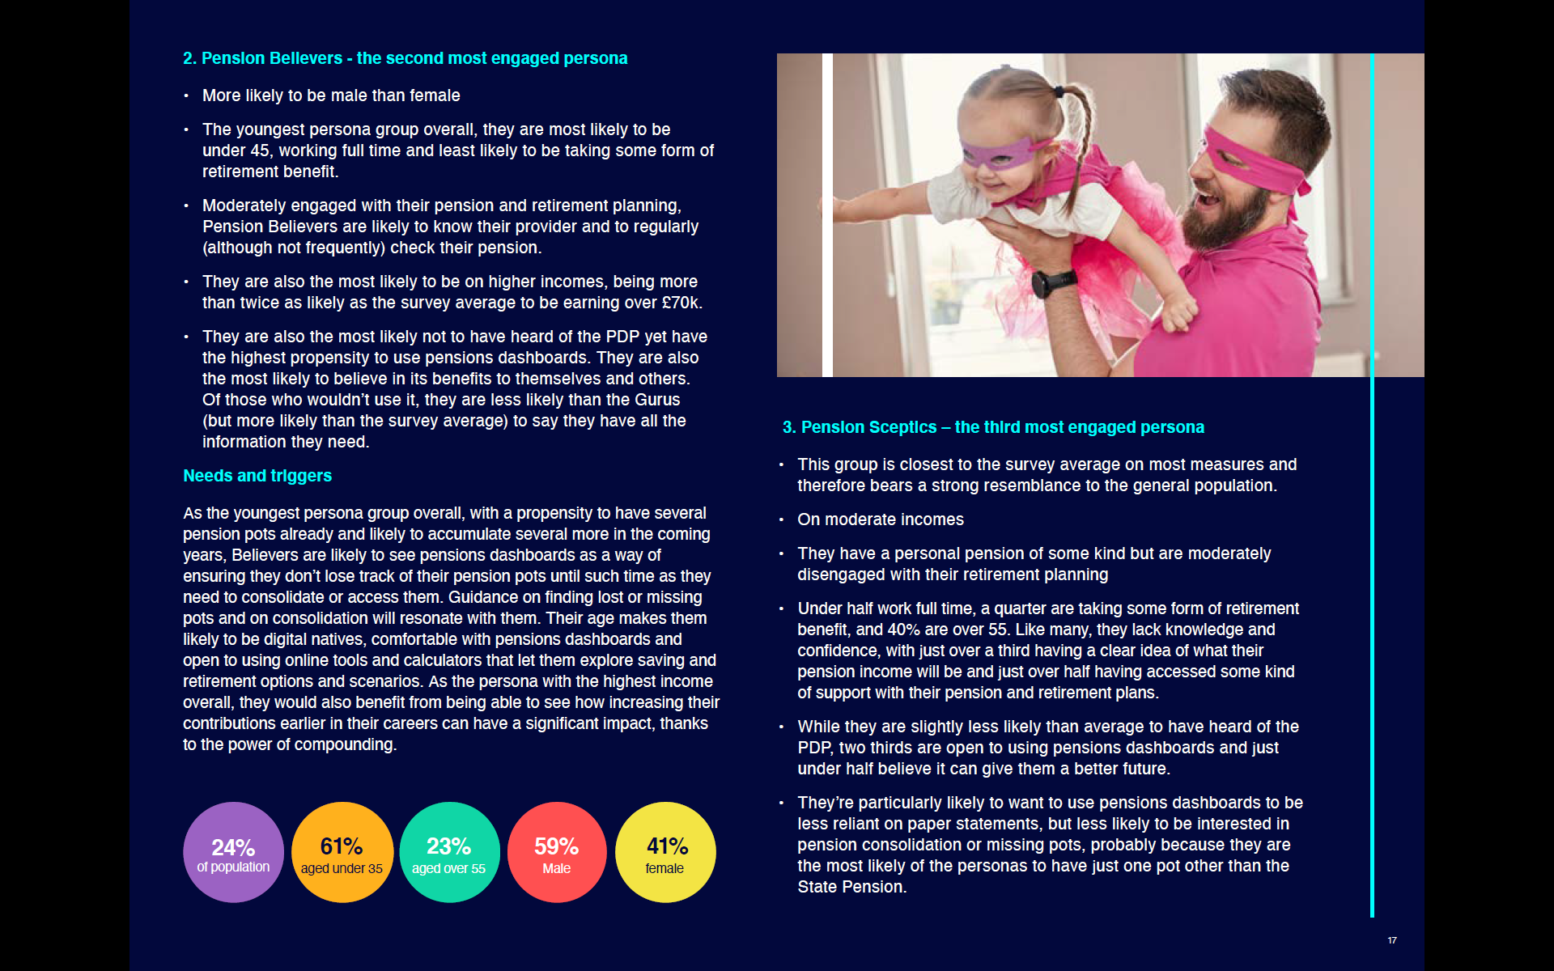
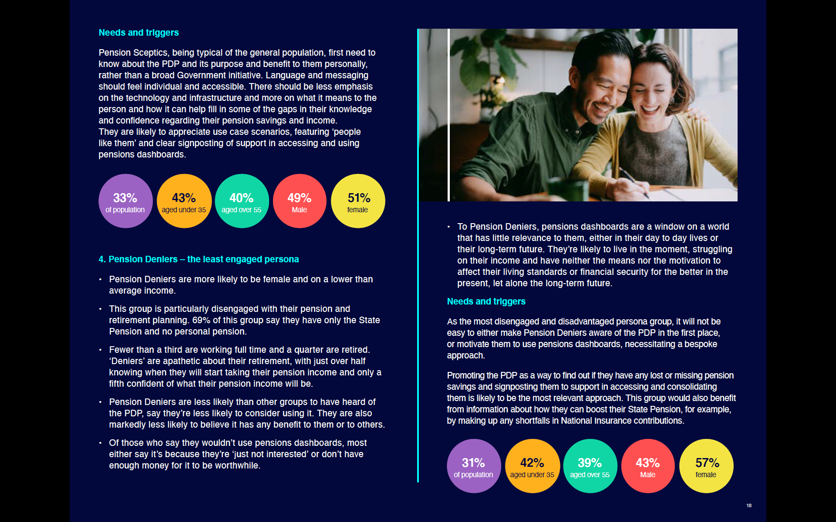
Capita independent research, 2023

Slide 19
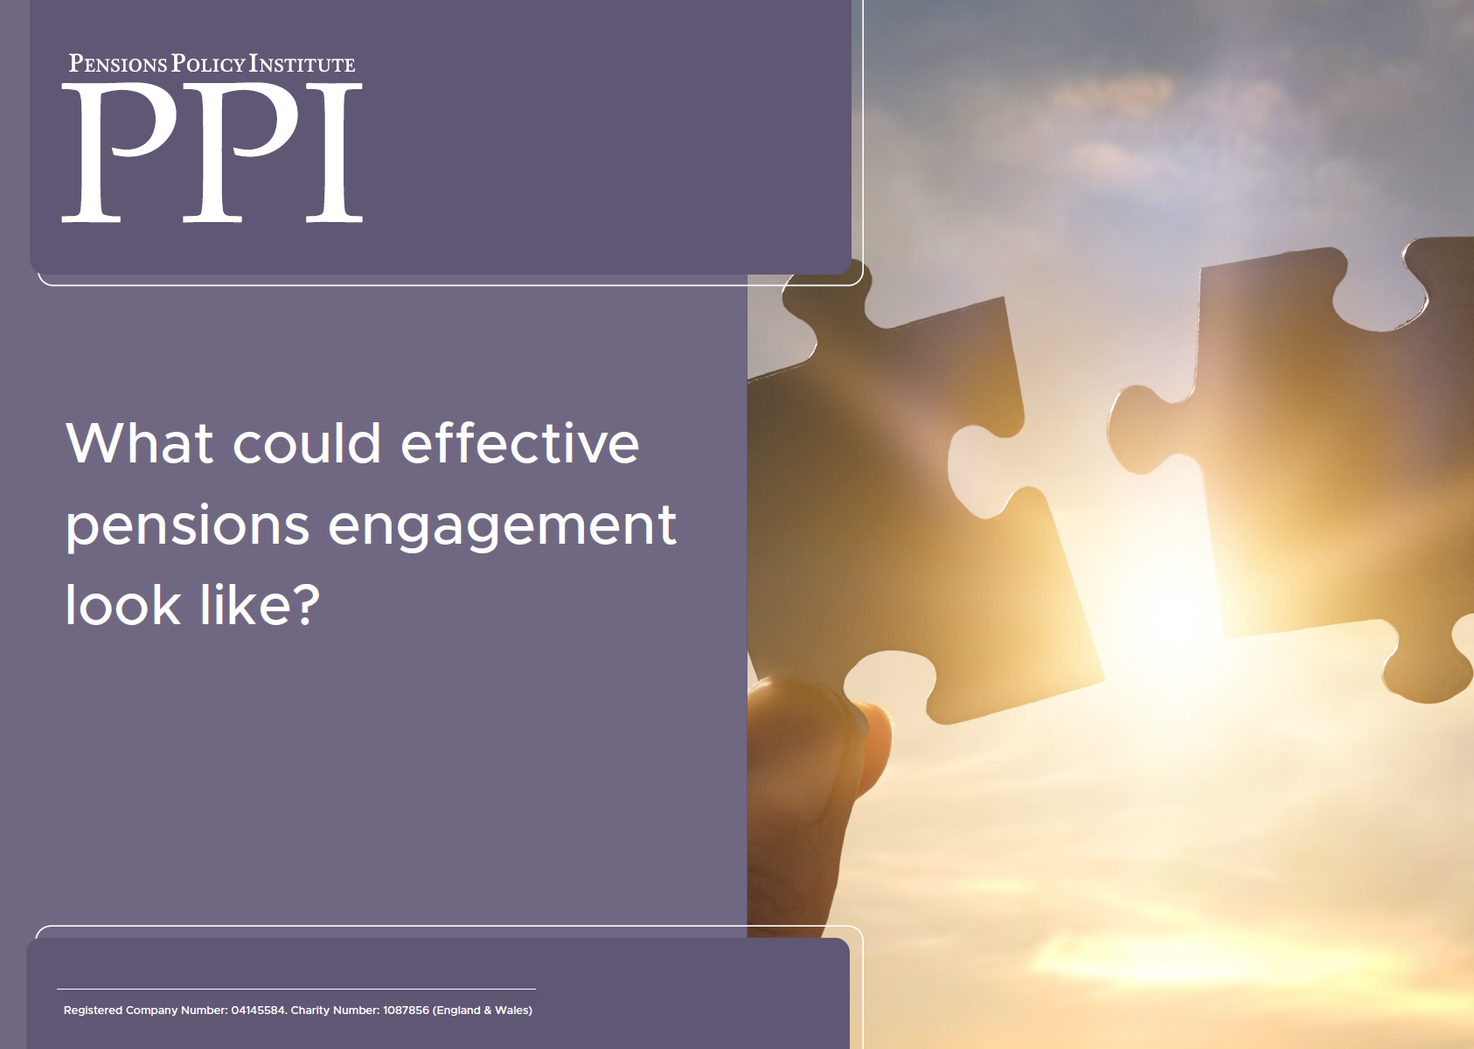
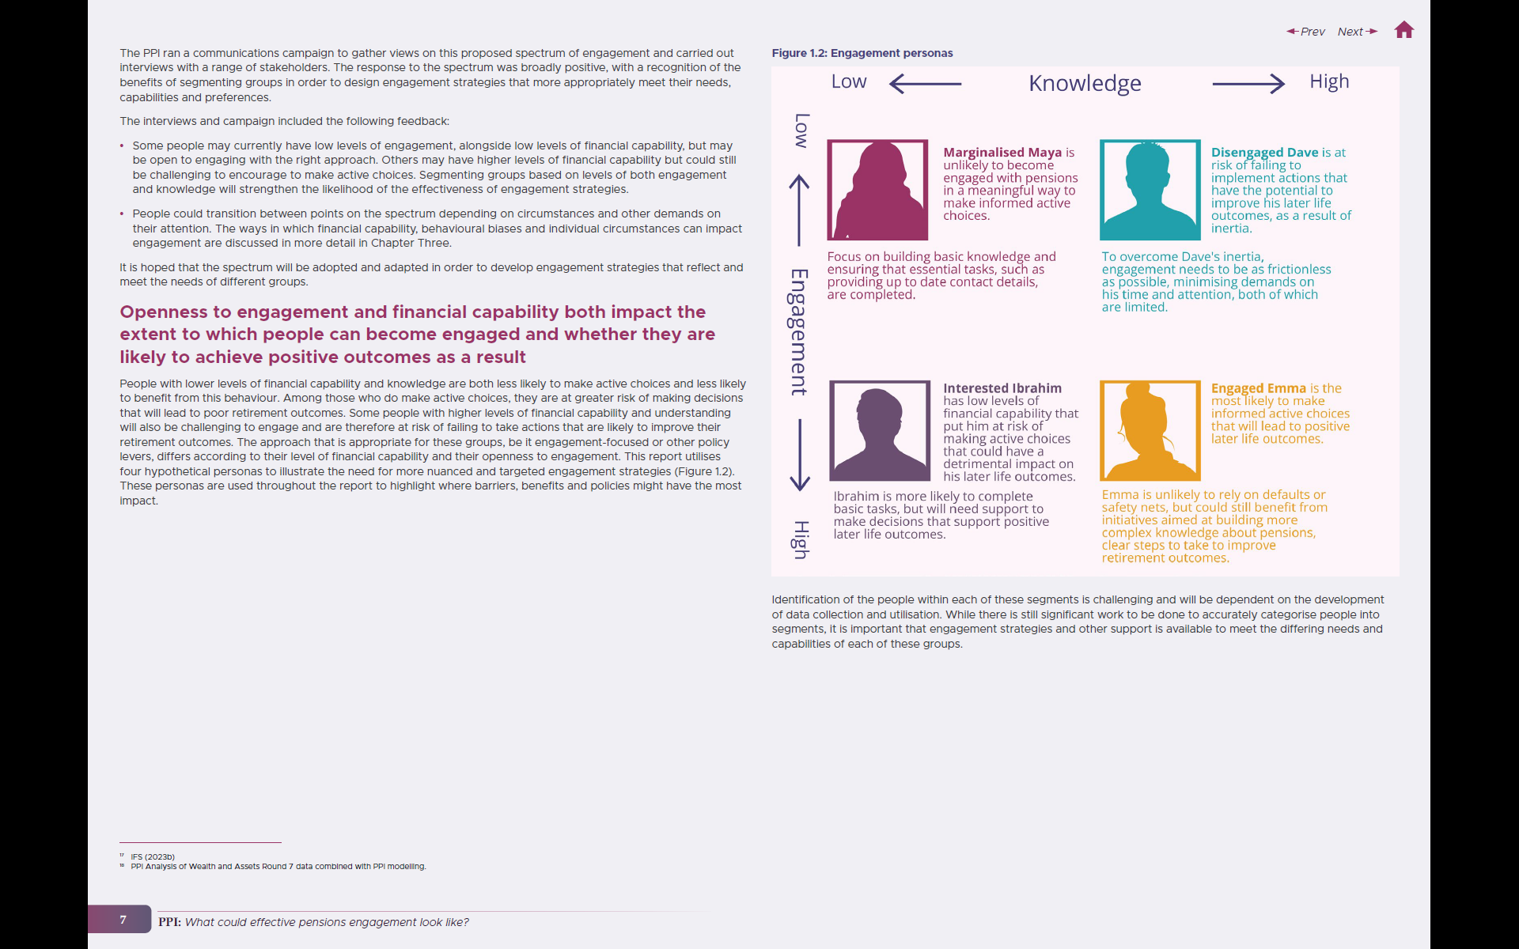
Pensions Policy Institute (PPI), Engagement policy paper, 2024

Slide 20
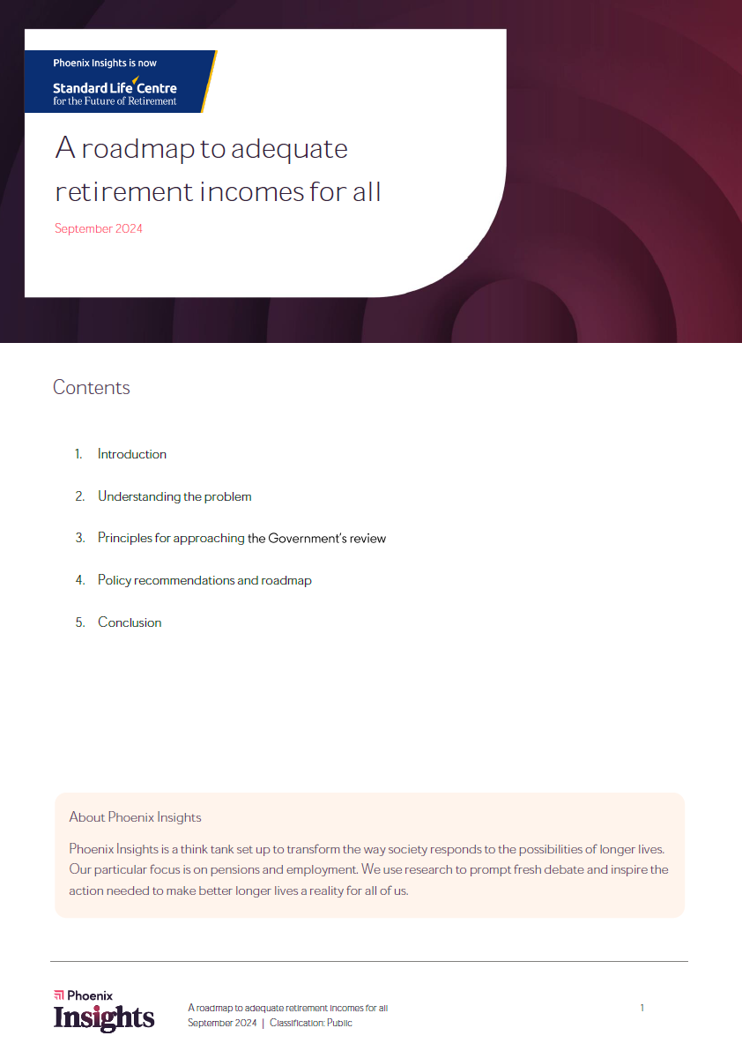
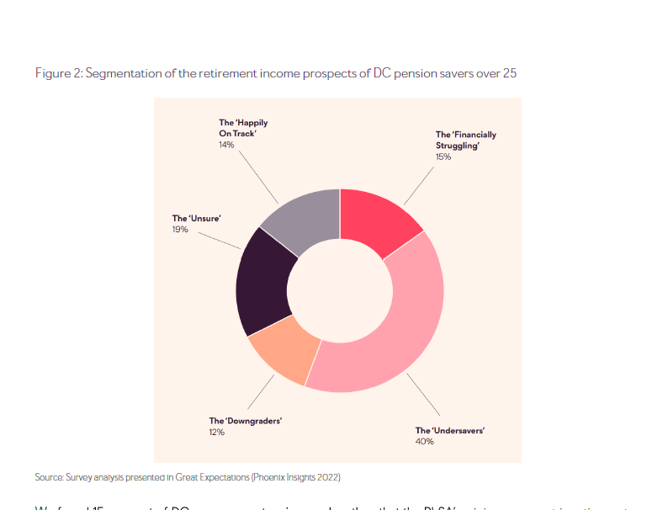
Standard Life Centre for the Future of Retirement research, with Frontier Economics, 2024

Slide 21
65%
26%
15%
27%
23%
9%

Slide 22
Synthesised segmentation
SEI: Help Me Harry & Helen, WTW: Curious Camille & Uncertain Umberto, Capita: Pension Sceptics, PPI: Interested Ibrahim, SL: ‘Unsure’ & ’Downgraders’
SEI: Connected Charlie & Claire, WTW: Informed Isabelle, Capita: Pension Gurus, PPI: Engaged Emma, SL: ‘Happily On Track’
Afraid Arifa Confused & Concerned 15% 6.2 million UK WAAs
Confident Bob & Proactive 9% 3.8 million UK WAAs
Bringing together the various consumer segmentation findings, models and thinking from:
2022: SEI Master Trust (and Ignition House)
2023: WTW, blog based on admin experience Capita (Independent research) 2024: Pensions Policy Institute (PPI) Standard Life Centre Future Roadmap 2025: MoneyHelper Pensions Dashboard
plus, the real pensions dashboards experience of: a) five continental European dashboards teams*, and b) testing private sector dashboards at Moneyhub
suggests the synthesised model on the right (based on c.40m UK Working Age Adults (WAAs)).
* Belgium, Denmark, Sweden, Norway and The Netherlands
High
Simpler
Quicker
Confused & Too Busy 27% 10.7 million UK WAAs
More “now”
Proactivity
Disengaged & Inactive 26% 10.5 million UK WAAs Detached Darshan
Confident & Passive 23% 9.4 million UK WAAs Complacent Chloe
Nudging consumers towards the green “top right” segment, requires pensions dashboards to be simpler, quicker & more “now” than comms today
Low
SEI: Blissfully Ignorant Ben & Becky, WTW: Disinterested Dan, Capita: Pension Deniers, PPI: Marginalised Maya, SL: ‘Financially Struggling’
SEI: Procrastinating Pete & Paula, WTW: “Change my mind” Caroline, Capita: Pension Believers, PPI: Disengaged Dave, SL: ‘Undersavers’
Low
Knowledge
High

Slide 23
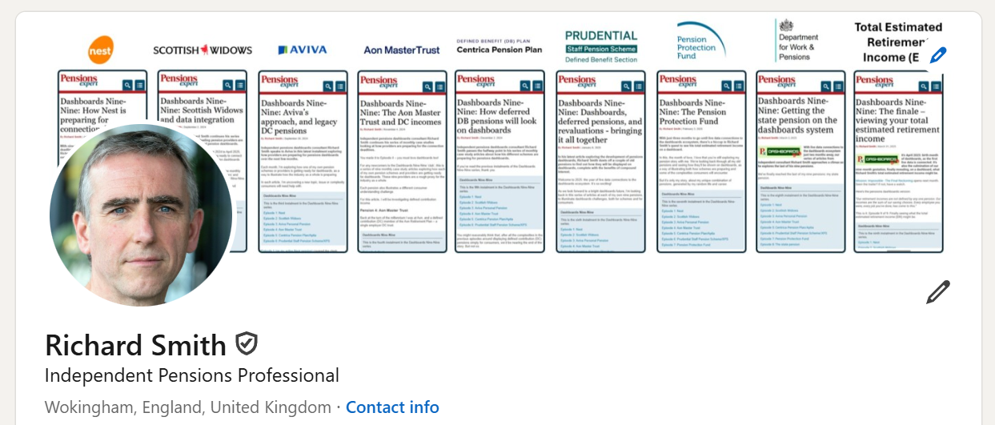
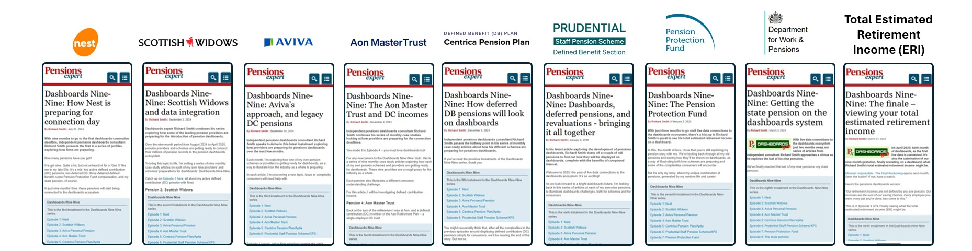

Slide 24
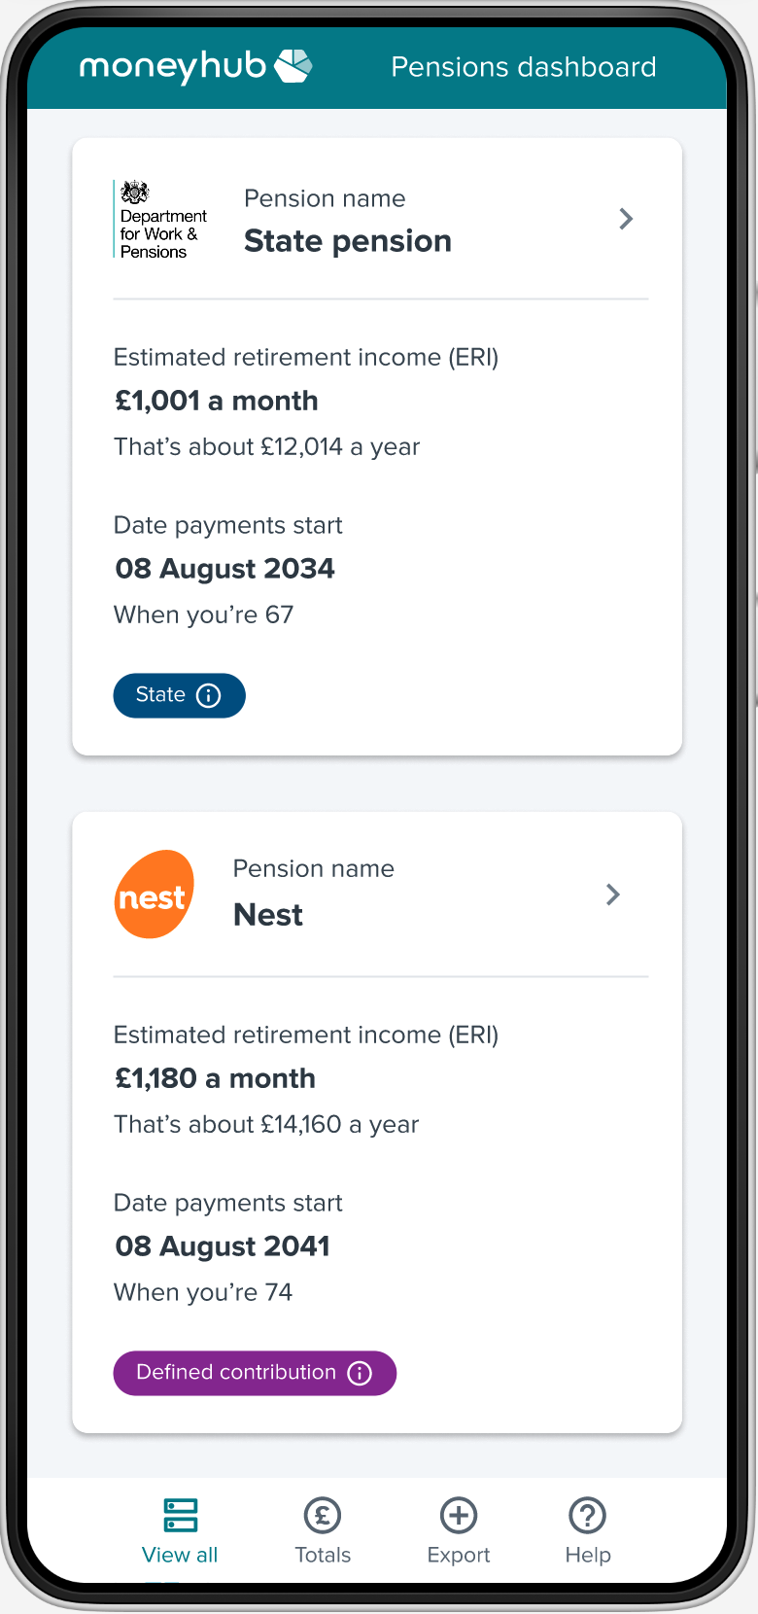
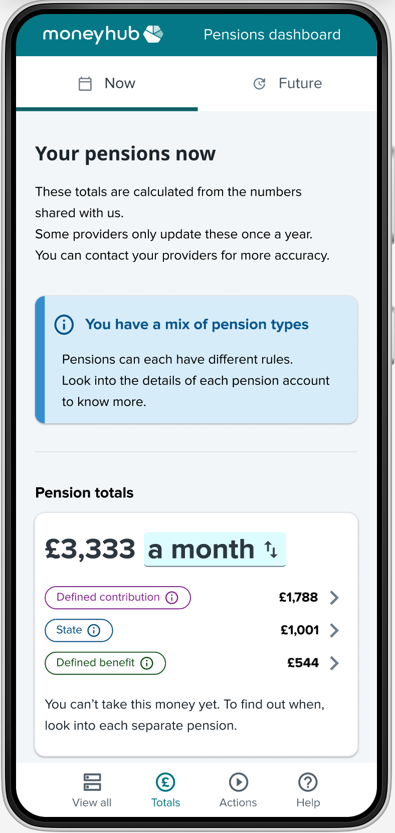
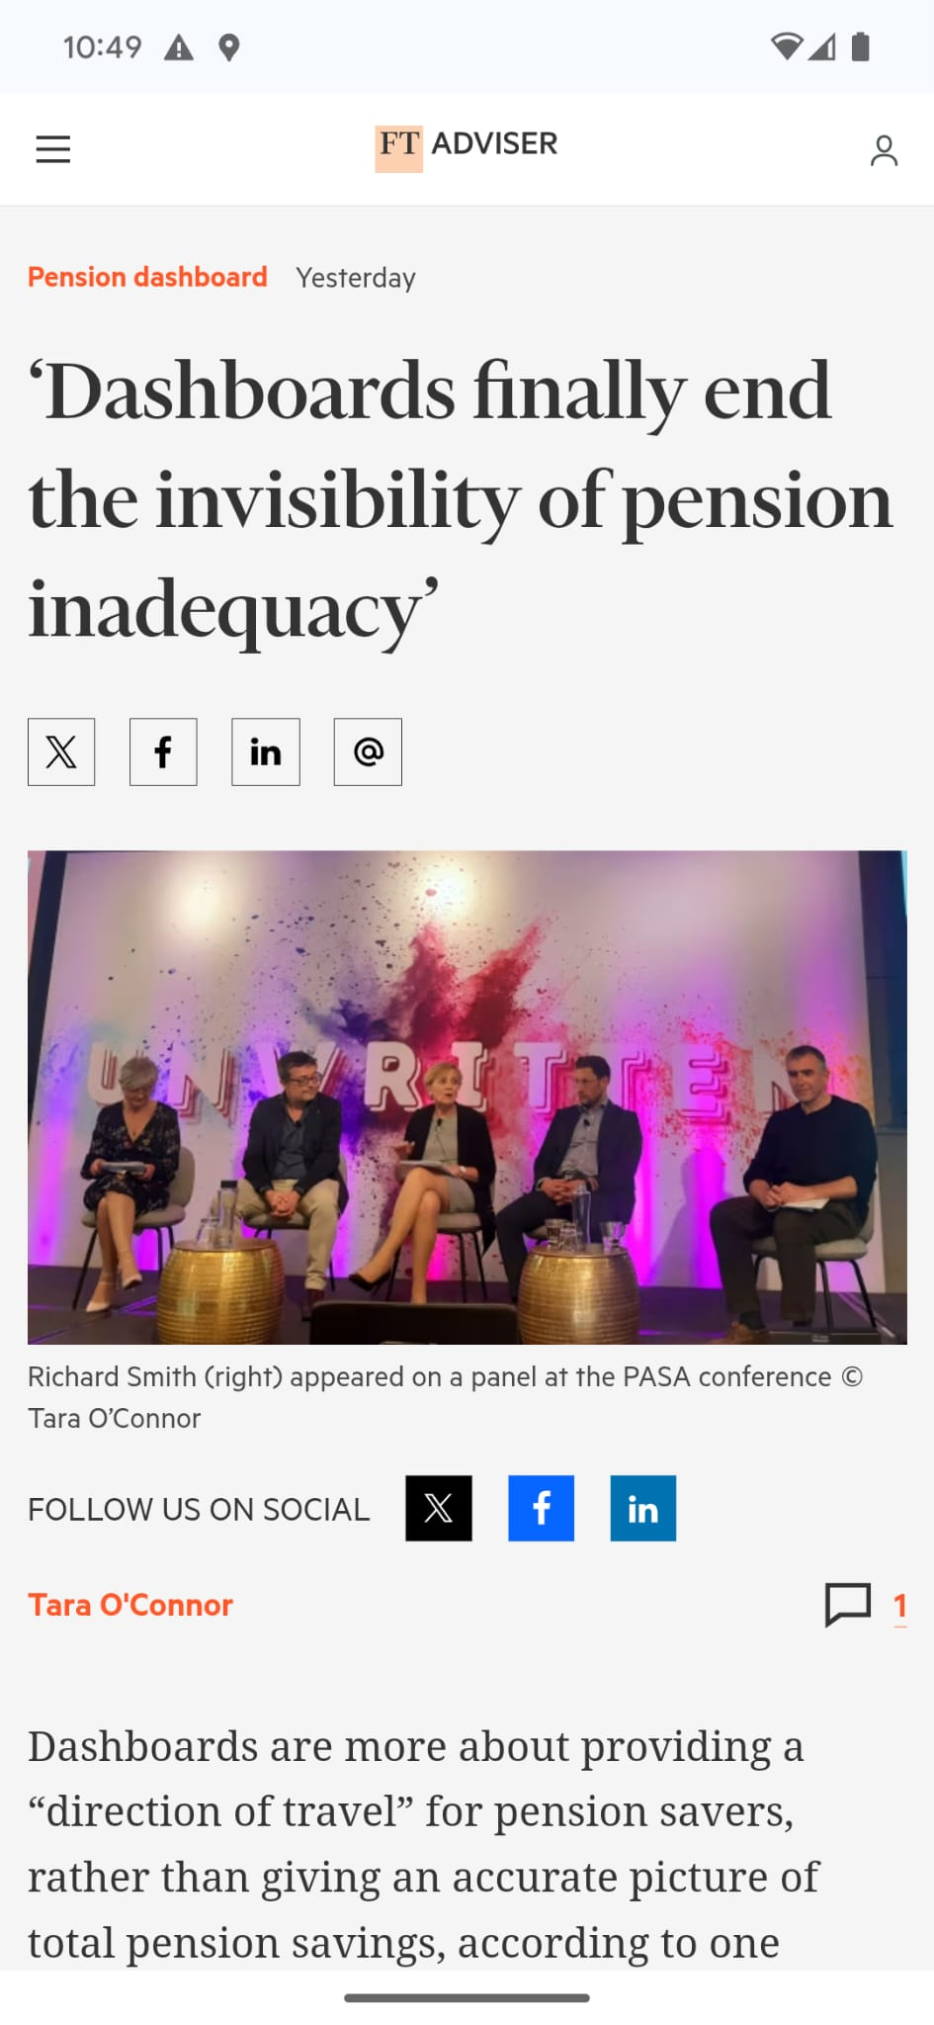
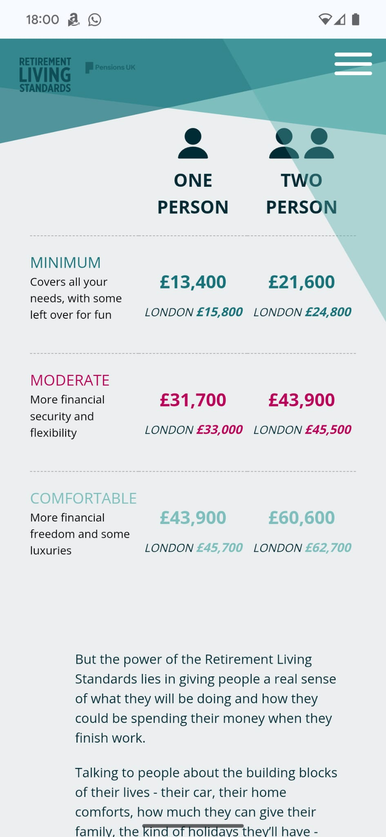
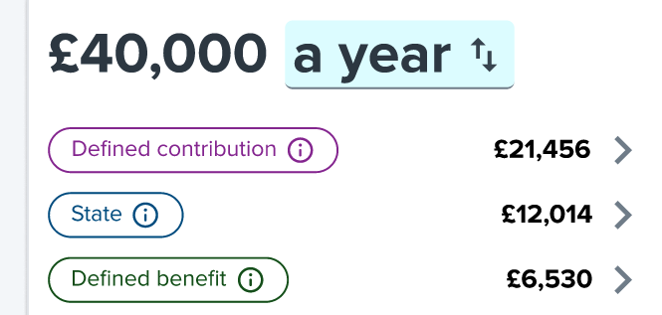

Slide 25


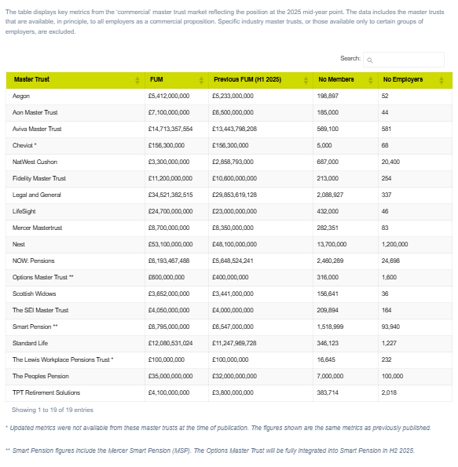

Slide 26
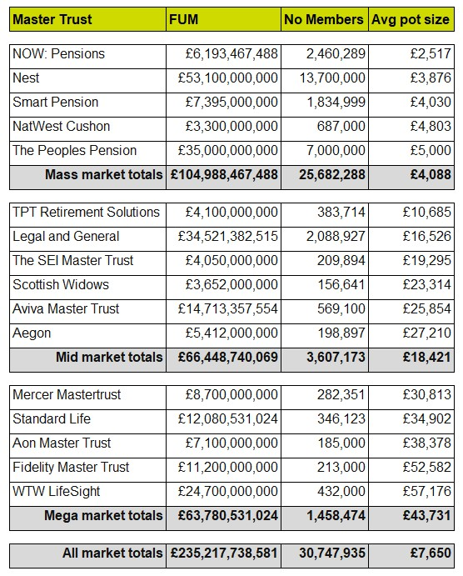

Slide 27
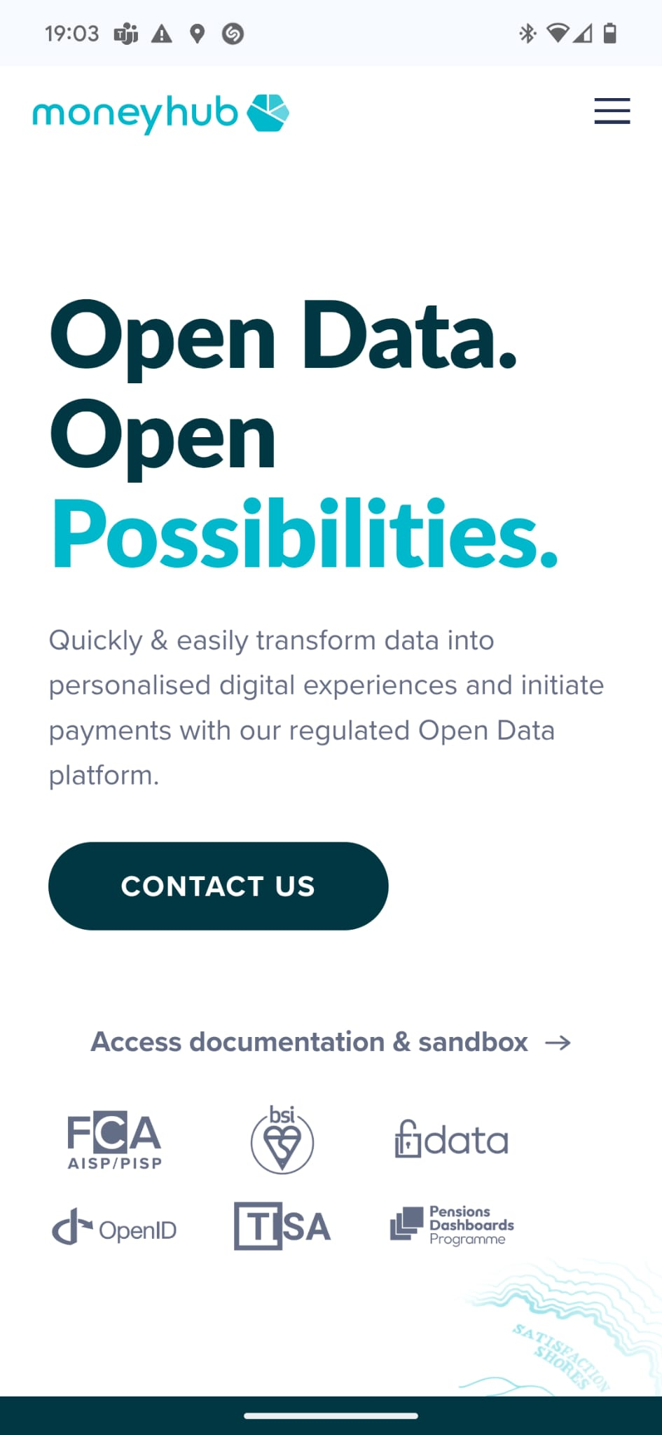
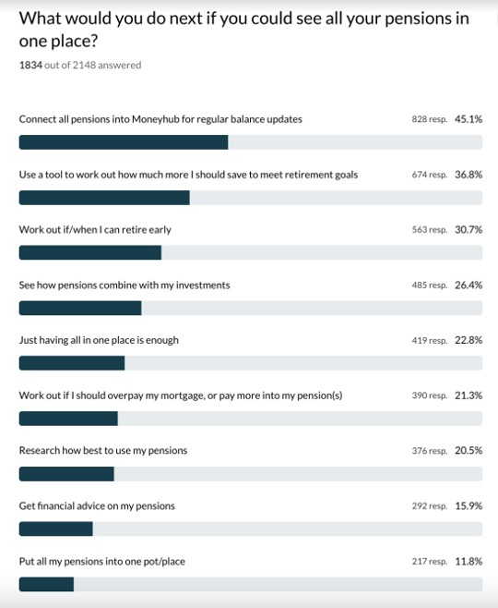

Slide 28
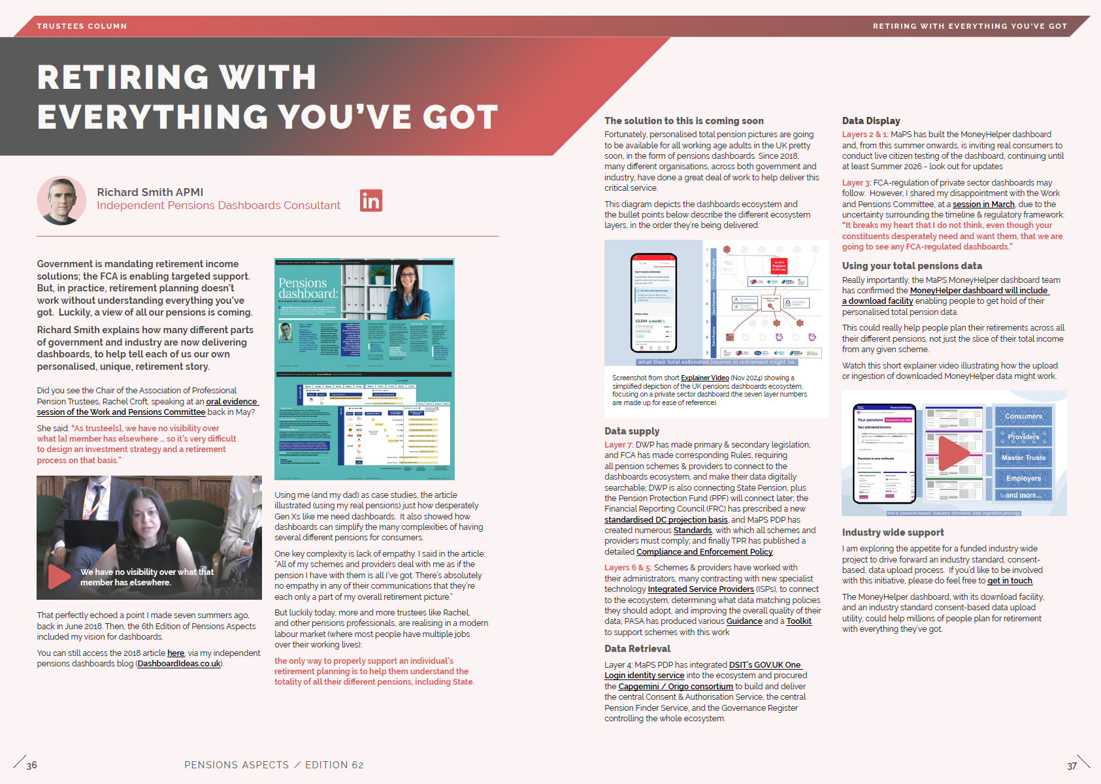

Slide 29
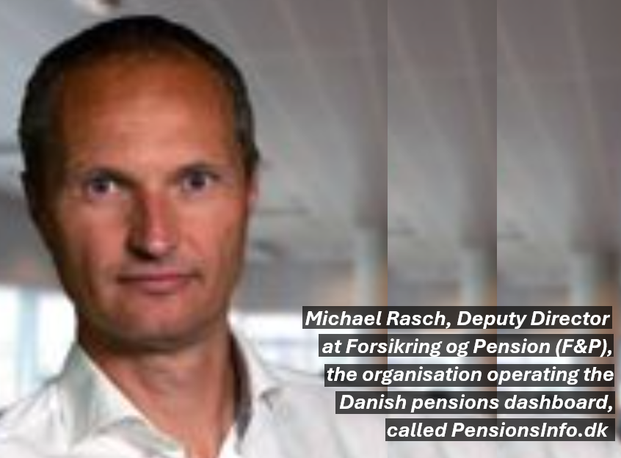
“Dashboards need to EVOLVE: start small, launch an early version, learn, and then iterate. Do not try and launch everything at once.”

